Slide 1
L2d4
Cu boulder
Csci 3155: principles of programming languages
Summer 2018
Spencer wilson
6/14/18

Slide 2
PLAN
Q&A before class assignment
Maps
In class exercise
Lab 3
Coding

Slide 3
Coding in Class
It’s the last day of class for Lab2. We will likely do a bit of coding on the lab together in class today. Be ready for that

Slide 4
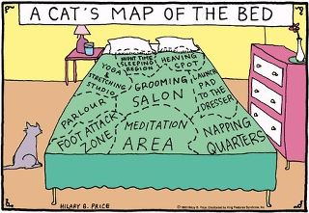
JOKE

Slide 5
Brain Teaser – Env
// Using Expr from lab 2
type Env = Map[String, Expr]
val empty: Env = Map()
val myEnv = empty
println("environment was " + myEnv)
myEnv + ( "mykey" -> S("myVal") )
println("and now it is " + myEnv)

Slide 6
Brain Teaser – Env
// Using Expr from lab 2
type Env = Map[String, Expr]
val empty: Env = Map()
val myEnv = empty
println("environment was " + myEnv)
val myEnvp = myEnv + ( "mykey" -> S("myVal") )
println("and now it is " + myEnvp)

Slide 7
ANNOUNCEMENTS
Lab 2 is due tomorrow at 8pm (automatic 24 hour extension)
Sign up for Lab 2 interview by Monday at 6 am
Don’t forget to write down the time of your interview
Let us know if absolutely none of the times work for you
Lab 3 is live

Slide 8
New Team policy
Make teams if you’d like
Teams can be up to size 3
Whether or not you are on a team PLEASE consider discussing the course material with other students – it should help you master the material

Slide 9
Lab 2 interview
Grammars
Be able to determine if a sentence exists in a language
Be able to draw parse trees to demonstrate that a sentence exists in the language
Be able to demonstrate ambiguity in a grammar
Understand javascripty₁
know how each operator
Truethy vs Falsey
Short circuiting
You will not be coding during this interview.

Slide 10
Midterm
Midterm Exam : Tuesday 06/26/2017 5pm – 6:20pm
That’s a bit less than two weeks out
My next Tuesday I’ll release a study guide and practice exam.
I’ll bring print outs to class

Slide 11






Slide 12
Questions?
?
Before class assignment

Slide 13
Coding with Env
See IntelliJ

Slide 14
Questions?
?
Coding with environments

Slide 15
The Parser
See IntelliJ
Lab2Worksheet.scala

Slide 16
Questions?
?
Parsing

Slide 17
Questions?
?
Lab 2

Slide 18
Tips and Tricks Lab 2
For subexpressions <ei>:
Never call to<Type>( <ei> )
Instead call to<Type>( eval( env , <ei> ) )

Slide 19
Tips and Tricks Lab 2
For each subexpression <ei>:
Only evaluate it to a value once, or not at all
Avoid excessive-evaluation (causes excessive side effects)

Slide 20
Tips and Tricks Lab 2
That weird Circle with a Cross in it symbol…
Typeset this with a Cross
It is just a random symbol
It is often used in Logic books to mean XOR

Slide 21
Tips and Tricks Lab 2
Question 2.e. asks: using the definition of `A` from question 2.d., use the Downarrow judgment form to write infernce rules that determine the number of `a` symbols in a sentence in the language.

Slide 22
Tips and Tricks Lab 2
Something like this will be useful in the toNumber function :
// MyStr : String
try { myStr.toDouble } catch { case _ => Double.NaN }

Slide 23
Lab 3

Slide 24
Types
Lab 2
Lab 3
Numbers
Strings
Booleans
Undefined
Numbers
Strings
Booleans
Undefined
Functions

Slide 25
Language Abilities
Lab 2
Lab 3
Arithmetic
Boolean logic
Concatenation
Printing
Non-mutable variable declarations
Lab 2 +
Function definitions (+ scoping)
Function calls

Slide 26
Big concept
Dynamic scoping
We often* DON’T want Dynamic scoping
Fun fact : LaTex is dynamically scoped
Fun fact: python classes are dynamically scoped
Static scoping
I dare say most PL are statically scoped, at least about functions

Slide 27
Inference Rules
This lab uses a lot of inference rules!
Like… a lot!
Labs 4 and 5 also rely quite hevily on inference rules
Fun fact… many of the big step inference rules ( the ones that use \turnstyle \Downarrow ) could be used to implement Lab 2

Slide 28
In class exercise

Slide 29
In Class Exercise
Derive the value using the inference rules available in Lab 3 handout:
Evaluate : Y + 3
In the Environment : [ Y -> true ]

Slide 30
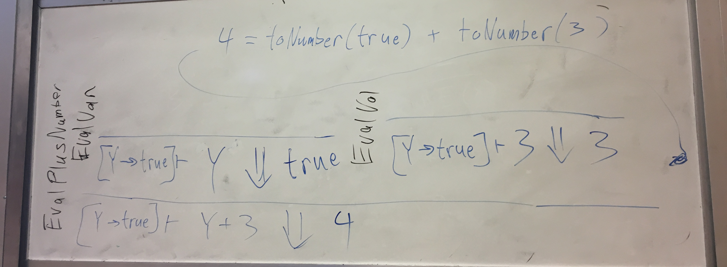
Solution

Slide 31
Questions?
?
In Class Exercise

Slide 32
Coding Lab 2
For the rest of class today

Slide 33
// TODO
Lab 2 is due tomorrow at 8pm (automatic 24 hour extension)
Sign up for Lab 2 interview by Sunday at 8 pm
Don’t forget to write down the time of your interview
Let our Grader know if absolutely none of the times work for you
Lab 3 is live. It’s not due for a while…

Slide 34
JOKE

